Slide 1






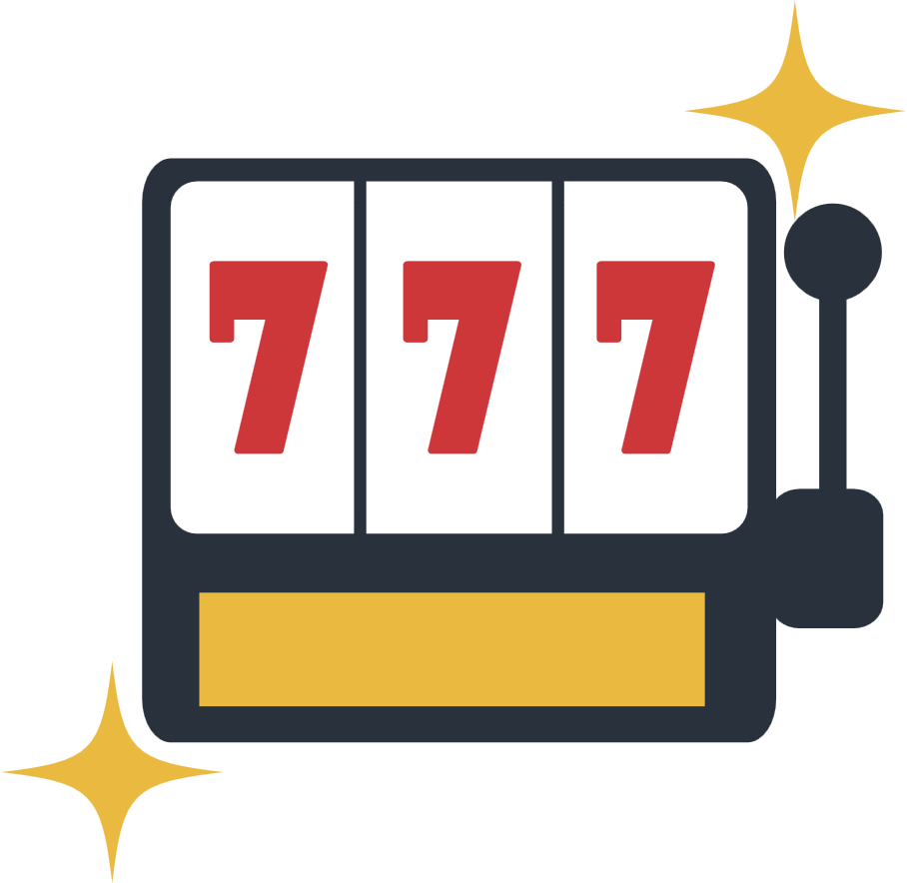




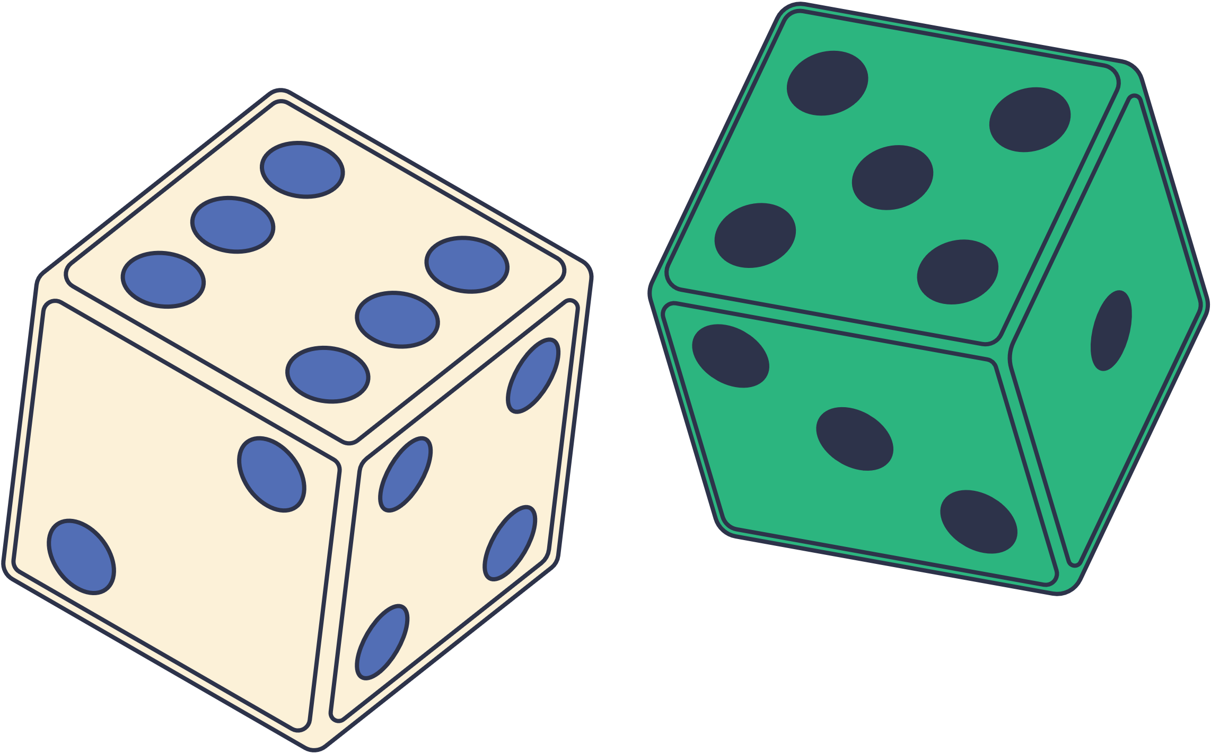

Expectation in Lotteries and Games
THE TEAM K
Vishal
Yogeshwari
Muhemmed Razi k
Fiza Noor k
Aman Jazim

Slide 2



INTRODUCTION
Lotteries seem random, but there’s deep math behind them.
What are the chances you’ll win? Lose?
This project dives into expected value and probability distributions to find out.

Slide 3



OBJECTIVES
OBJECTIVE 1
OBJECTIVE 2
Simulate realistic lottery conditions using different statistical models.
Understand how expectation, variance, distribution help analyze lottery fairness.

Slide 4

Concepts Used
MATHEMATICAL IDEAS:
Expected Value (E[X])
Mean & Variance
Distributions (Bernoulli, Binomial, Uniform, Normal)
FORMULAE RECAP:
Bernoulli: Mean = p,
Var = p(1-p)
Binomial: Mean = np,
Var = np(1-p)
Uniform: Mean = (a+b)/2,
Var = ((b–a)²)/12
Normal: Mean = μ,
Var = σ2

Slide 5


OUTPUT SAMPLE
CSV-BASED INPUT DATA
Each user in the CSV file has:
Name
Tickets bought
Cost per ticket
Win probability
Realistic simulation of a lottery scenario for multiple participants.
Bernoulli → mean & variance (per person)
Binomial → more realistic with multiple tickets
Uniform → models equal outcomes (for cost range)
Normal → approximates expected outcome shape
Tabulated results displayed for clarity

Slide 6

Python Code Logic
Reads CSV using csv module
Applies all four distributions to each person
Calculates & prints mean + variance per distribution
Uses math for square roots, matplotlib.pyplot for graphs

Slide 7


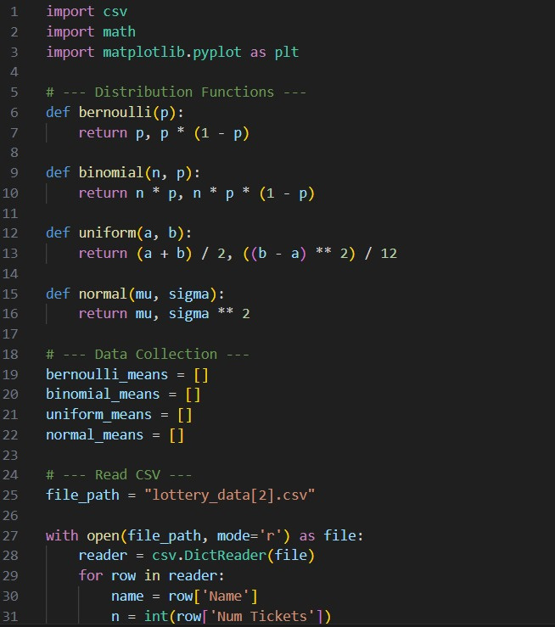
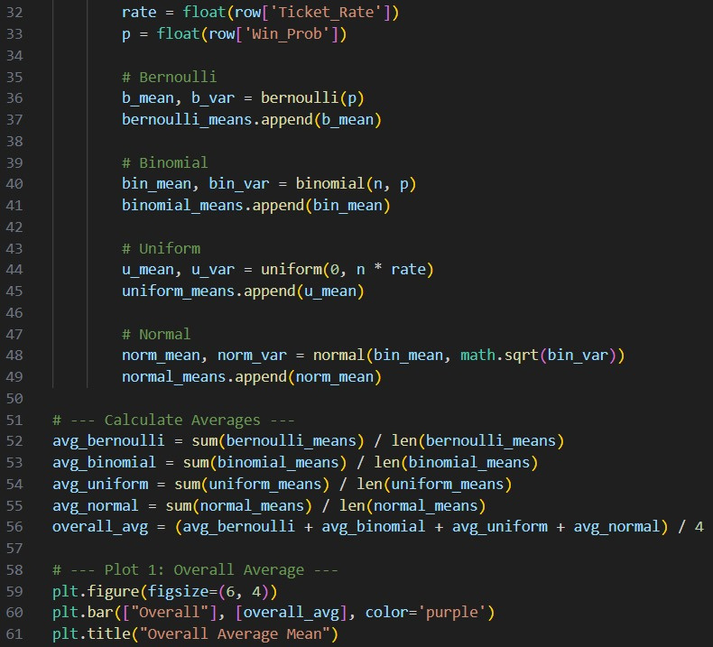
CODE:

Slide 8

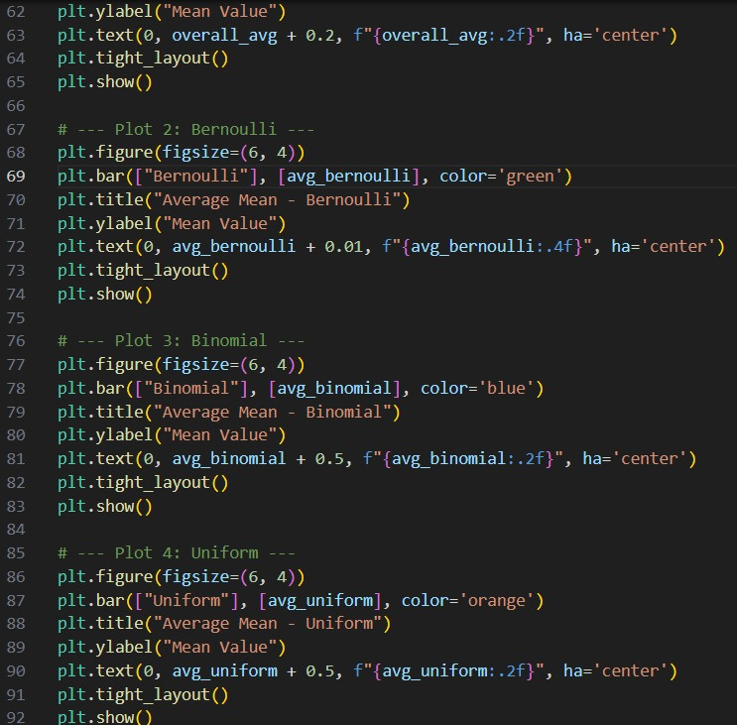


Slide 9
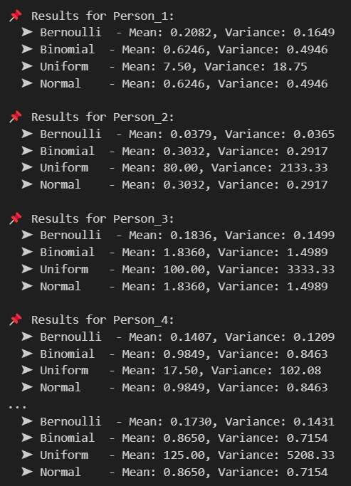
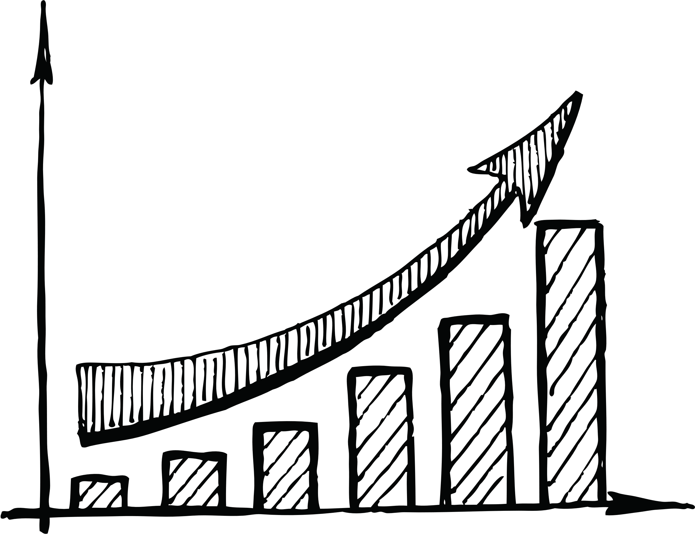
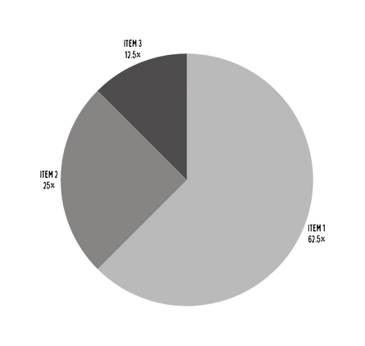
OUTPUT:

Slide 10
Visualizations
Five bar graphs plotted:
Overall average across all distributions
Avg Bernoulli mean
Avg Binomial mean
Avg Uniform mean
Avg Normal mean

Slide 11
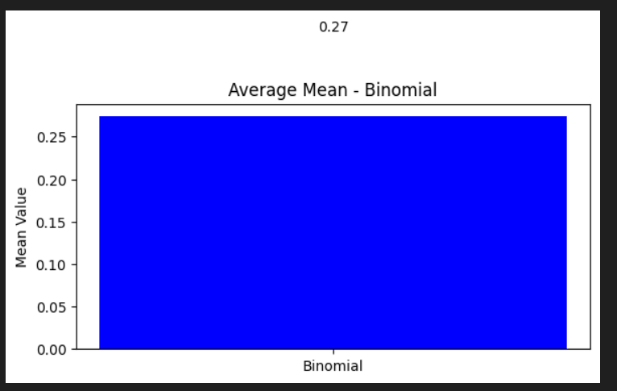
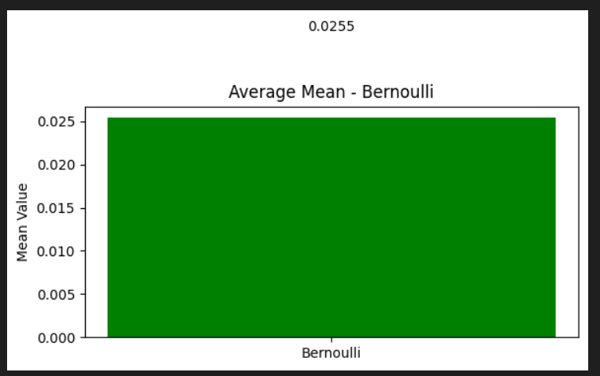
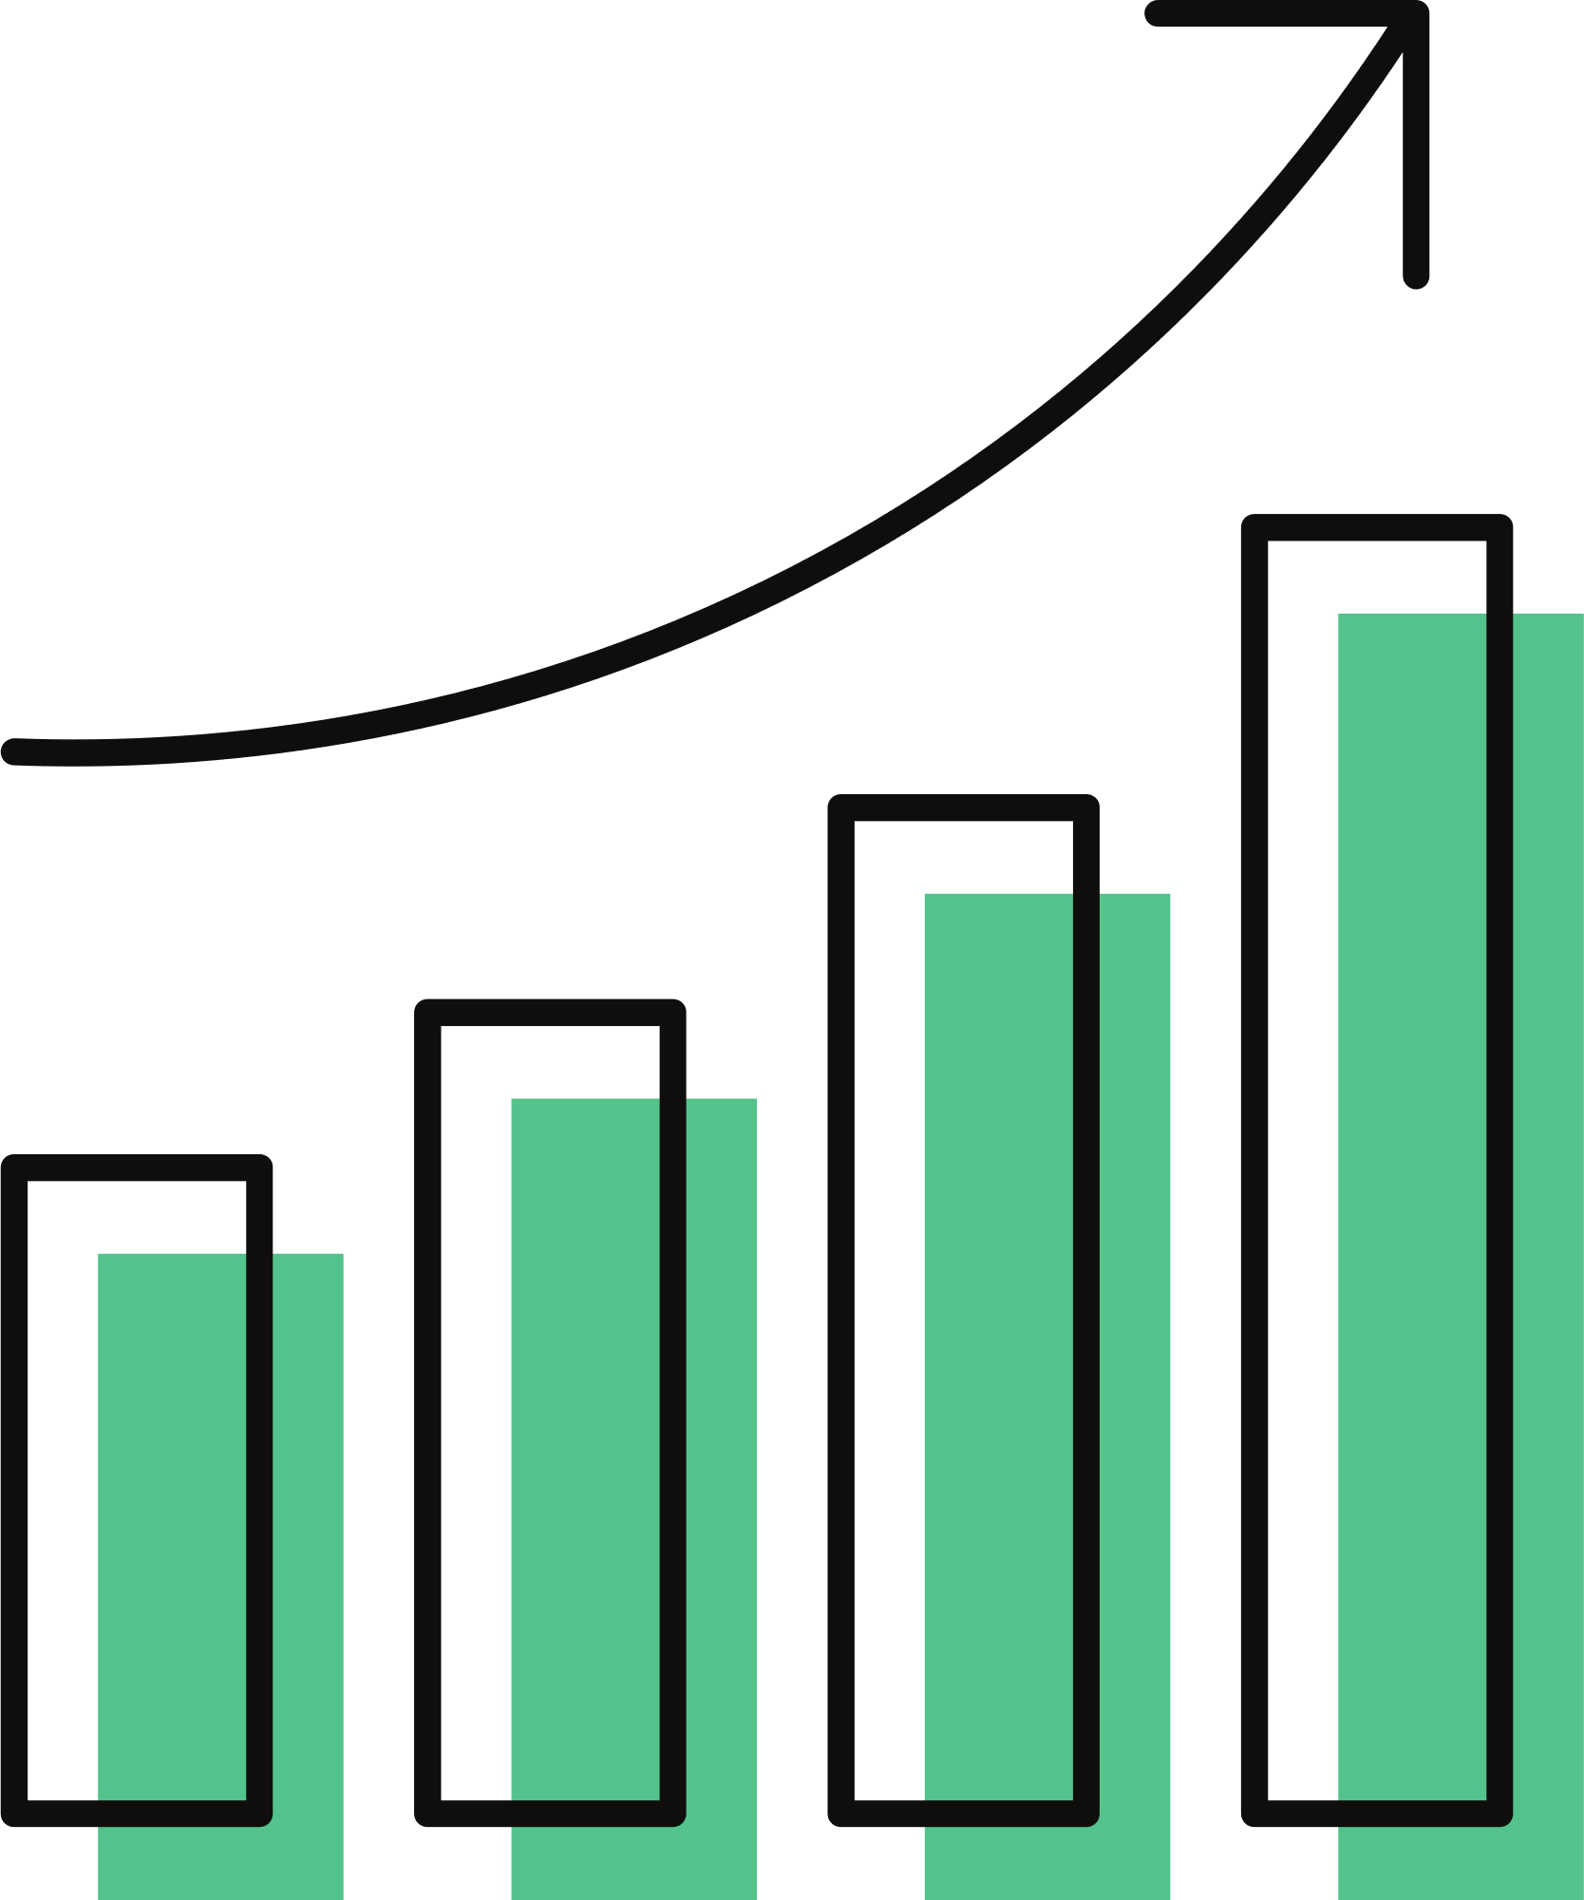

Slide 12
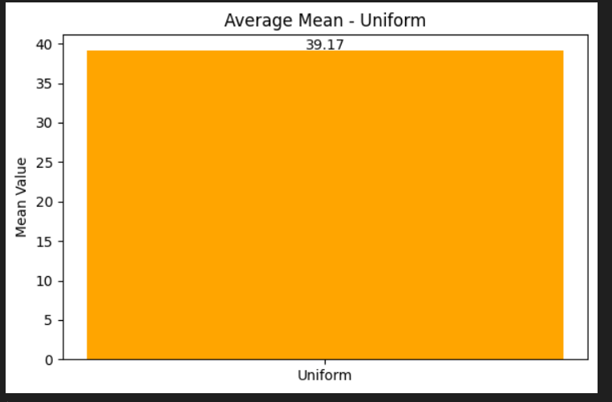
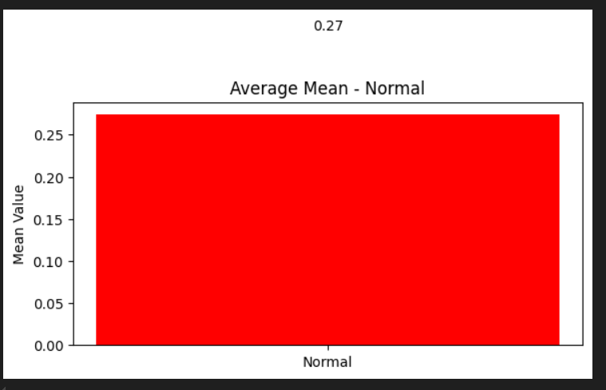
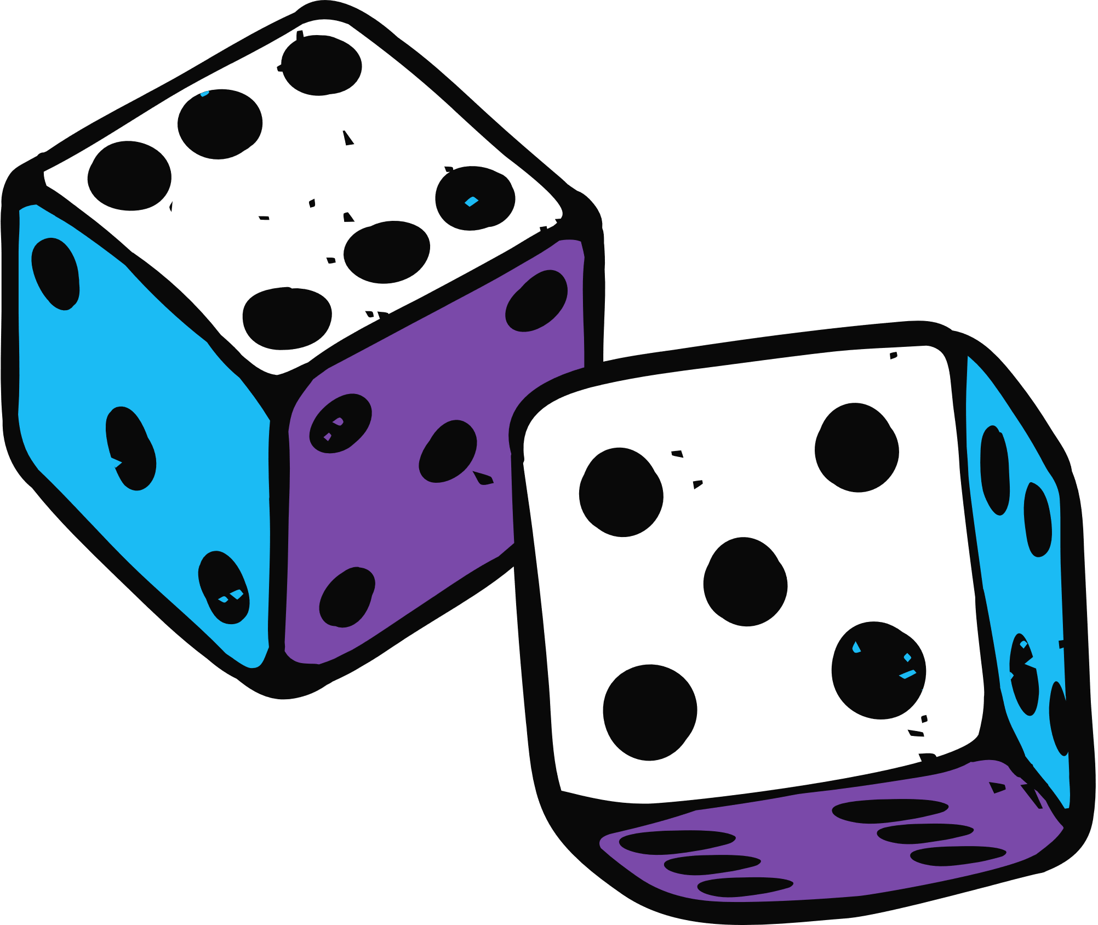

Slide 13
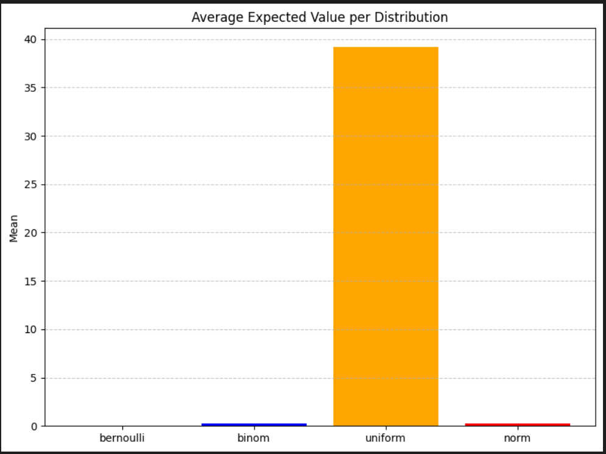
OVERALL GRAPH

Slide 14



FUTURE SCOPE
Add more distributions: Poisson, Geometric
Expand to game theory & strategic decision-making
Apply to real-world data like fantasy leagues, online games

Slide 15

CONCLUSIONS
Most people have negative expected returns → lotteries = profit for organizers!
Binomial fits best for real-life ticket buying.
Variance helps identify unpredictability in winnings.

Slide 16


THANK YOU!

